Slide 1

IMPROVING RECOVERY RATES – CASE STUDY SOLUTION
TANMAY NAGDEVE

Slide 2
Key Insights
~71% accounts fall in Low Recovery (DPD 90+).
Recovery Rates:
High → 20%
Medium → 13%
Low → 4.5%
Medium Recovery segment holds ₹652M (highest outstanding amount).
Even customers with good history fall into low recovery → DPD alone is insufficient.

Slide 3
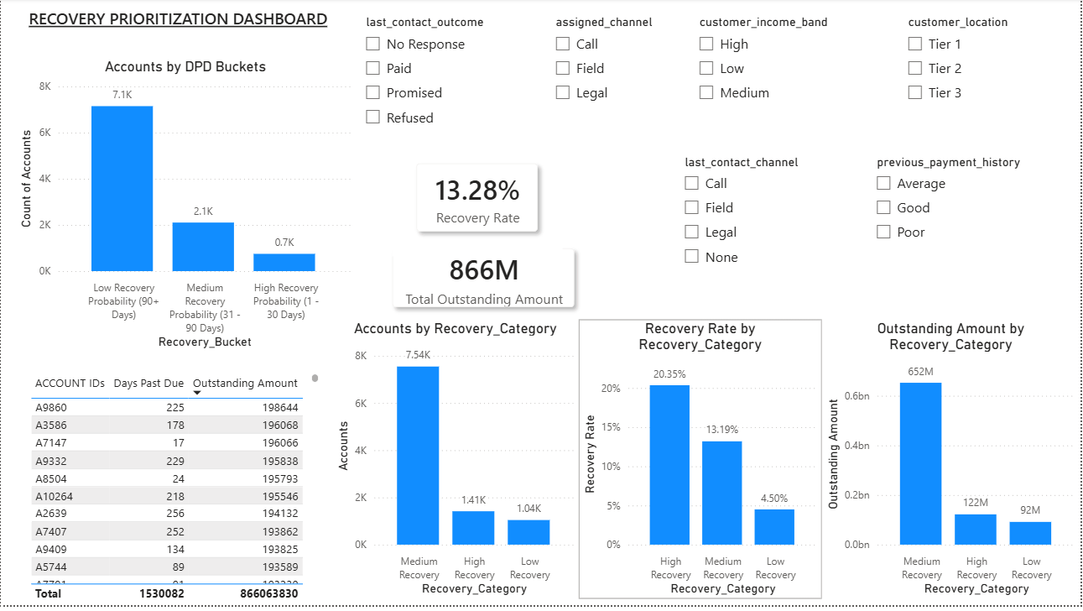

Slide 4
Strategy
Account Prioritization
Low Recovery →High Risk (NPAs)
Medium Recovery → Highest Opportunity
High Recovery → Low effort
Channel Strategy (Outcome-Based)
Refused → Legal + Field
No Response → Call + Field
Promised → Follow-ups
High Recovery → SMS / Calls
Resource Optimization
Legal & Field → Only high-risk accounts
Calls/SMS → Medium & High segments

Slide 5
Expected Impact
Focus on ₹652M Medium segment → highest ROI
Prevent Medium → Low slippage
Apply targeted legal/field actions for low recovery accounts.
Business Outcomes:
Improved overall recovery rate
Better agent productivity
Reduced unnecessary legal/field costs
Even a 5% improvement on ₹652M can generate ₹30M+ additional recovery

Slide 6
Supporting Approach
Data-Driven Approach
Multi-factor scoring (DPD + Outcome + History + Income) Enables accurate prioritization.
Enables consistent and scalable decision-making.
Reduces dependency on manual judgement.

